Slide 1
Area of a trapezium
Perimeter and area

Slide 2
how to use Oak lessons

Slide 3
I can derive and use the formula for the area of a trapezium.

Slide 4
A trapezium is a quadrilateral with a pair of parallel opposite sides.
The plural of trapezium can be referred to as trapezia or trapeziums.

Slide 5

Area of a trapezium
Building an area
Area of a trapezium via composite shapes
Formula for the area of any trapezium

Slide 6
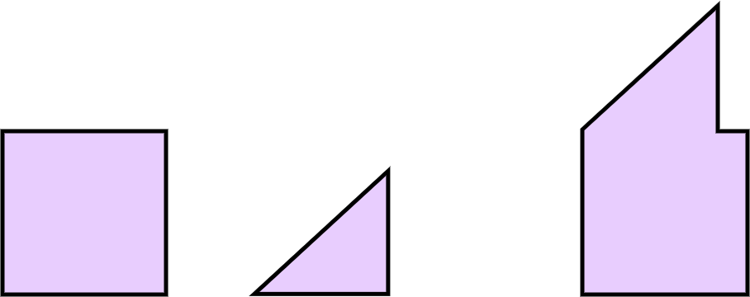
Building an area
The areas of basic shapes can be used to create a new composite shape with a given area.
Area = 90 cm²
Area = 35 cm²
Area = 125 cm²

Slide 7
Building an area
Do any of these composite shapes have different areas?
+

Slide 8
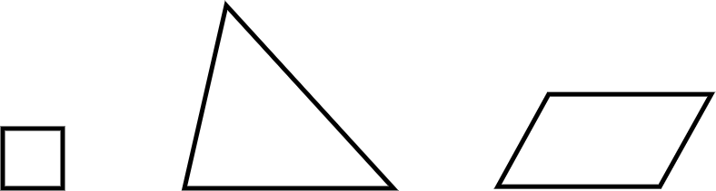

Building an area
Which of the shapes could be combined to create a new shape with an area of 200 cm²?
Two triangles
25 cm² 100 cm² 75 cm²
One square and one triangle
One square, one triangle and one parallelogram

Slide 9
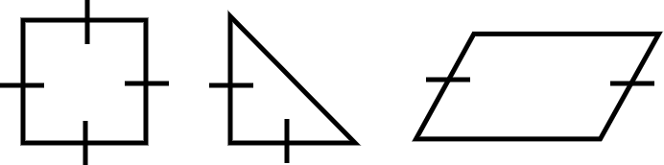
Building an area
1) State how many of each shape should be used to create a composite shape with the stated area.
a) Area = 24 cm² b) Area = 50 cm² c) Area = 60 cm²
Area = 16 cm² Area = 8 cm² Area = 18 cm²

Slide 10
Building an area
1) State how many of each shape should be used to create a composite shape with the stated area.
a) Area = 24 cm² b) Area = 50 cm² c) Area = 60 cm²
Area = 16 cm² Area = 8 cm² Area = 18 cm²

Slide 11
Building an area
a) Area = 24 cm²
E.g. You can use three triangles. 3 × 8 = 24
Area = 16 cm² Area = 8 cm² Area = 18 cm²

Slide 12
Building an area
b) Area = 50 cm²
E.g. You can use two squares and one parallelogram.
16 + 16 + 18 = 50
Area = 16 cm² Area = 8 cm² Area = 18 cm²

Slide 13
Building an area
c) Area = 60 cm²
E.g.
You can use one square, one triangle and two parallelograms.
16 + 8 + 2 × 18 = 60
Area = 16 cm² Area = 8 cm² Area = 18 cm²

Slide 14
Area of a trapezium
Building an area
Area of a trapezium via composite shapes
Formula for the area of any trapezium

Slide 15
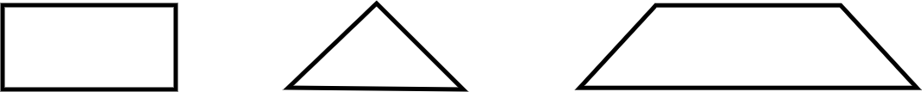
Area of a trapezium via composite shapes
Any trapezium can be made using a rectangle and a triangle.
=

Slide 16
Area of a trapezium via composite shapes
Area of a trapezium = area of rectangle + area of triangle
5 cm
5 cm
= +
2 cm
2 cm
2 cm
8 cm
5 cm
3 cm
Area of the trapezium = 2 × 5 + 2 × 3 × ½
Area of the trapezium = 10 + 3
Area of the trapezium = 13 cm²

Slide 17
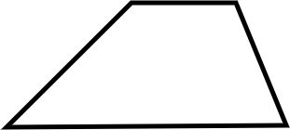
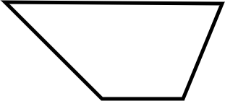
Area of a trapezium via composite shapes
3 cm
10 cm
7 cm
6 cm
11 cm
2 cm
Area = 3 × 7 + (11 - 3) × 7 × ½
Area = 21 + 8 × 7 × ½
Area = 21 + 4 × 7
Area = 21 + 28
Area = 49 cm²
Area = 6 × 2 + (10 - 2) × 6 × ½
Area = 12 + 8 × 3
Area = 12 + 24
Area = 36 cm²

Slide 18
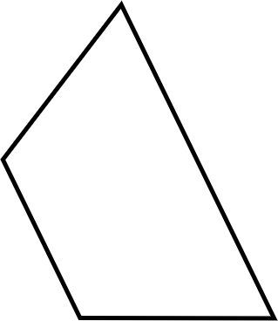
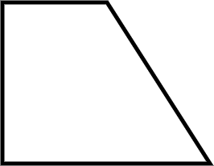
Area of a trapezium via composite shapes
1) Calculate the area of each trapezium.
a) b)
9 cm
12 cm
17 cm
4 cm
5 cm
20 cm
7 cm

Slide 19
Area of a trapezium via composite shapes
1) Calculate the area of each trapezium.
a)
9 cm
Area = 9 × 17 + (20 - 9) × 17 × ½
Area = 153 + 11 × 17 × ½
Area = 153 + 93.5
Area = 246.5 cm²
17 cm
20 cm

Slide 20
Area of a trapezium via composite shapes
1) Calculate the area of each trapezium.
b)
Area = 5 × 4 + (12 - 5) × 4 × ½
Area = 20 + 7 × 4 × ½
Area = 20 + 14
Area = 34 cm²
12 cm
4 cm
5 cm
7 cm

Slide 21
Area of a trapezium
Building an area
Area of a trapezium via composite shapes
Formula for the area of any trapezium

Slide 22
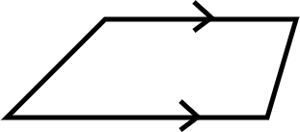
Formula for the area of any trapezium
This shape is a trapezium.
A trapezium has exactly one pair of parallel opposite sides.

Slide 23

Formula for the area of any trapezium
1) Instructions:
Take a piece of paper and fold it in half.

Slide 24

Formula for the area of any trapezium
1) Instructions:
Draw a trapezium on your piece of folded paper (try to make it different from mine).

Slide 25
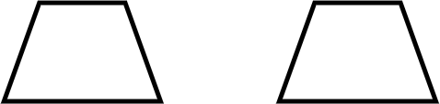
Formula for the area of any trapezium
1) Instructions:
Cut out your trapezium. You should have two identical trapeziums due to your folded paper.

Slide 26
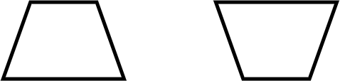
Formula for the area of any trapezium
1) Instructions:
Rotate one trapezium by half a turn. Place the two trapeziums next to each other.
Which quadrilateral did you make?

Slide 27
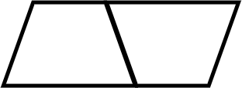
Formula for the area of any trapezium
You have made a parallelogram.

Slide 28
Formula for the area of any trapezium
The area of a trapezium is half the area of a parallelogram.
This is because two identical trapeziums can always be placed together to create a parallelogram.
Does this mean the formula for finding the area of a trapezium is the same as the formula for finding the area of a triangle?

Slide 29
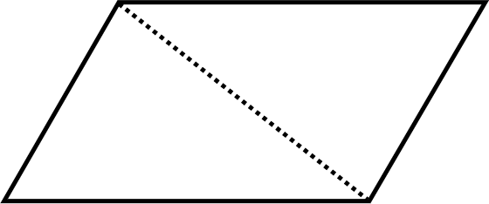
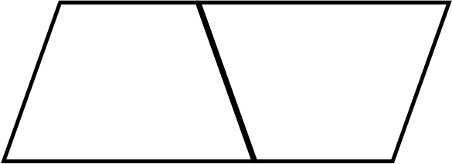

Formula for the area of any trapezium
Area = base × perpendicular height
=
Area = ½ × base × perpendicular height
=

Slide 30
Formula for the area of any trapezium
Is the statement: “The formula for the area of a trapezium is the same as the formula for the area of a triangle.”
Always true
Sometime true
One of the parallel sides would need to have length 0 units.
This would mean the trapezium was actually a triangle!
Never true

Slide 31

Area of a trapezium
A trapezium can be thought as a composite shape made from a rectangle and a triangle.
The area of any trapezium is half the area of the parallelogram made from two copies of that same trapezium.
Area of a trapezium =

Slide 32

© Oak National Academy 2024.
Produced in partnership with Mathematics in Education and Industry.
Licensed on the Open Government Licence v3.0, except where otherwise stated. See Oak terms and conditions.

